Slide 1

Project Take Away
MSandyFusion

Slide 2
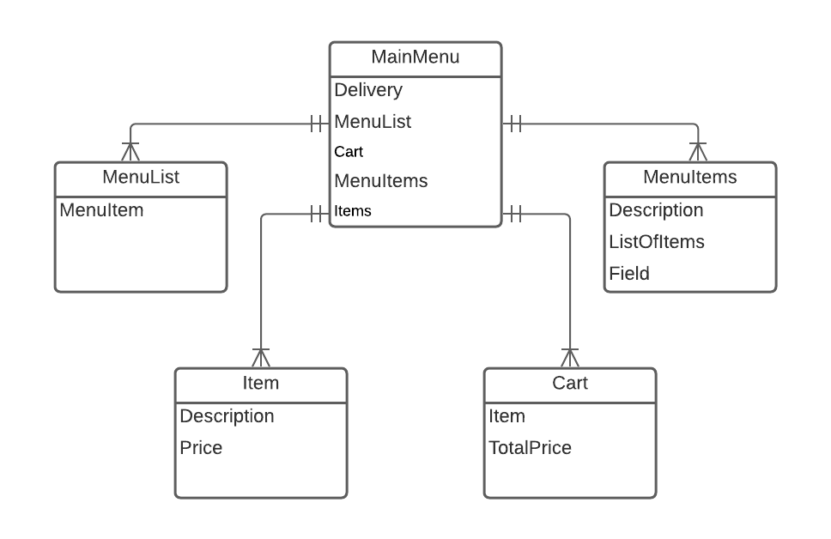
Flowchart

Slide 3
Screen Prototypes

Slide 4
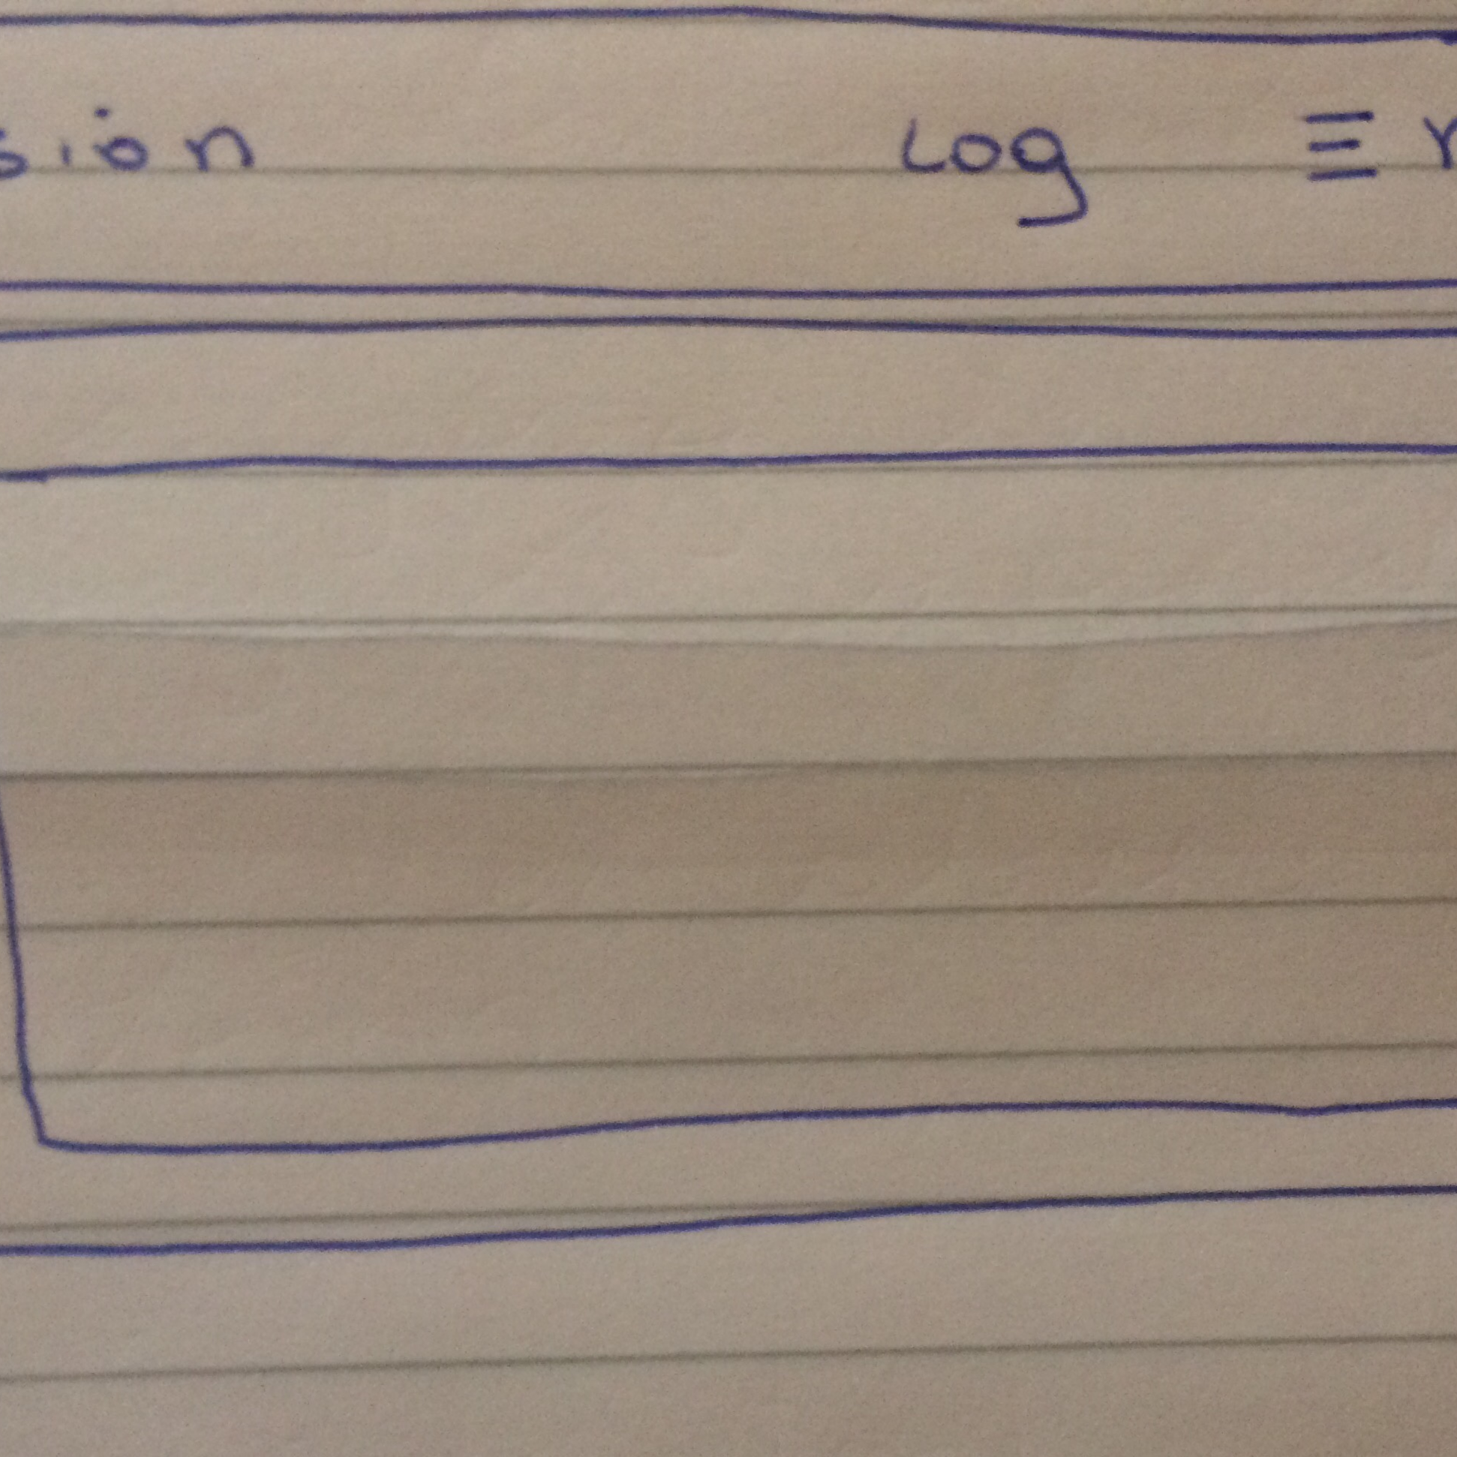
Main Menu

Slide 5
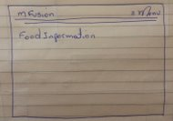
Food Options

Slide 6
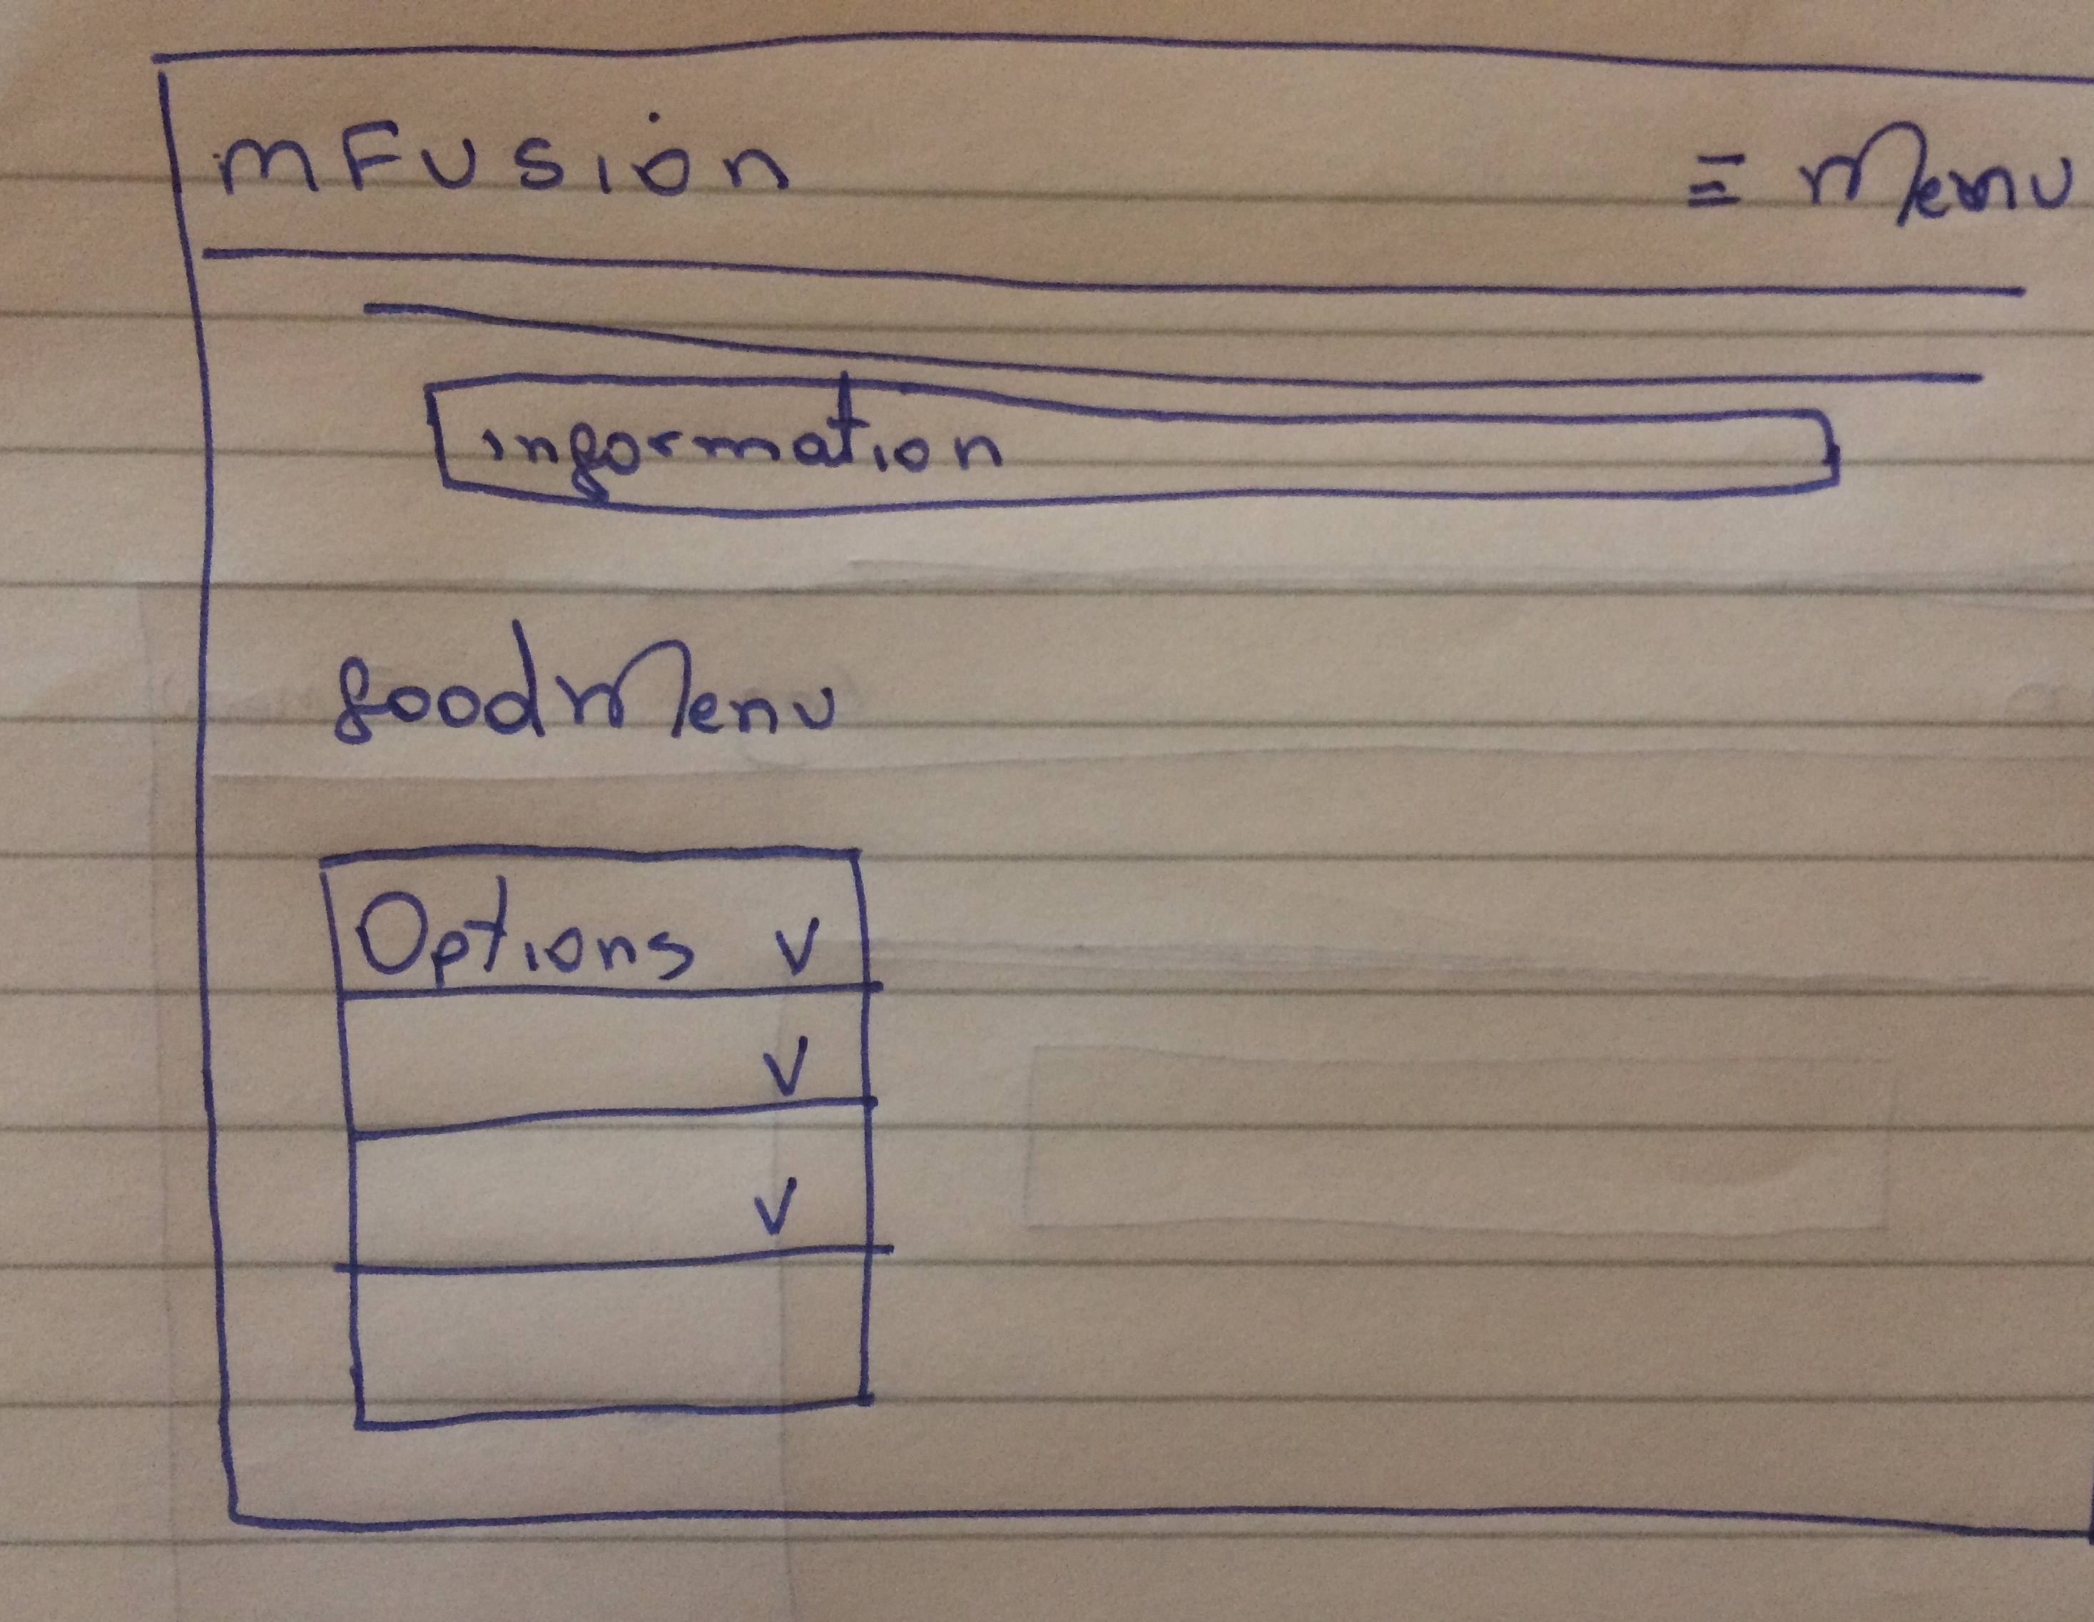
Food Menu

Slide 7
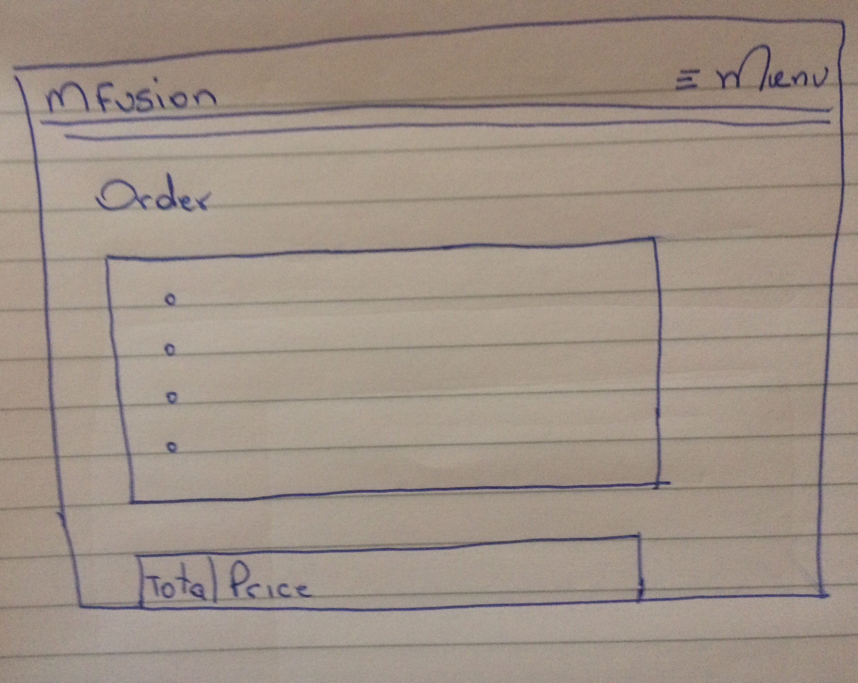
Cart

